Slide 1
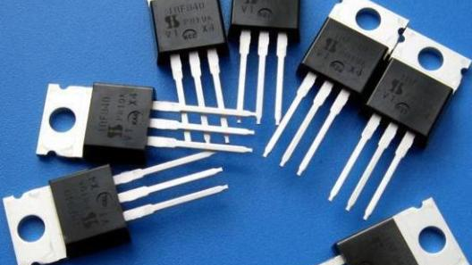
Field Effect Transistor
FET & JFET

Slide 2
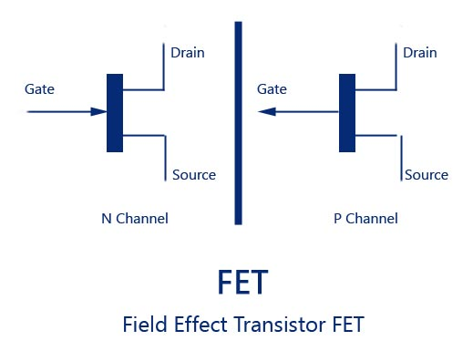
Field Effect Transistor
The FET or Field Effect Transistor is a three terminal device that uses an electric field to control the current flowing through the device - it also has a high input impedance which is useful in many circuits.
The FET consists of a semiconductor channel with electrodes at either end referred to as the drain and the source.
A control electrode called the gate is placed in very close proximity to the channel so that its electric charge is able to affect the channel.

Slide 3
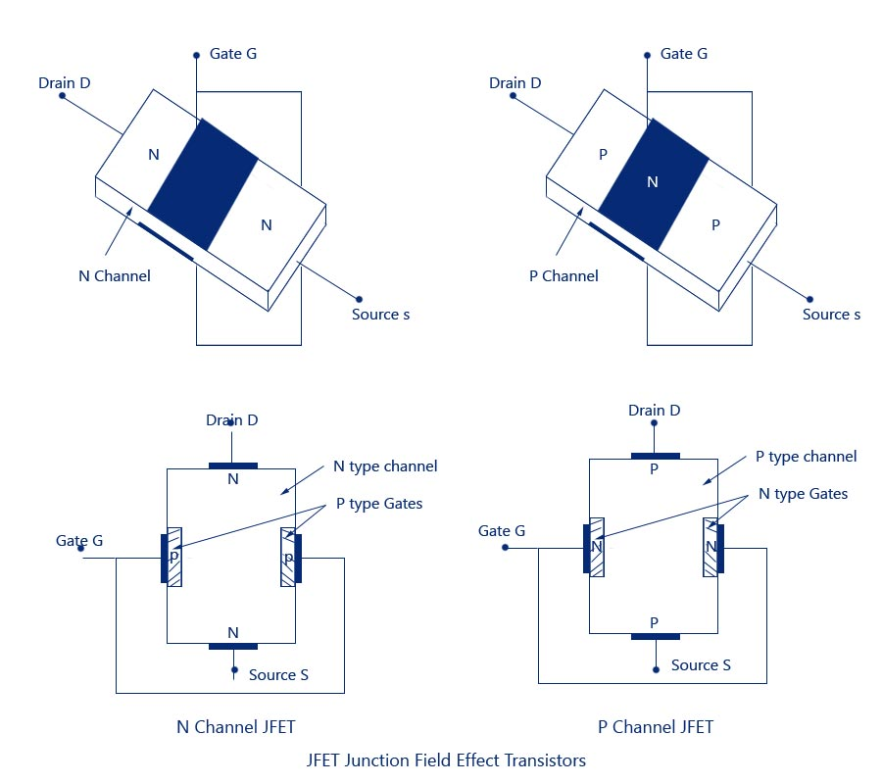
Junction FET

Slide 4
Construction of JFET
The structure is quite simple. In an N-channel JFET an N-type silicon bar, referred to as the channel, has two smaller pieces of P-type silicon material diffused on the opposite sides of its middle part, forming P-N junctions, as illustrated in figure.
The two P-N junctions forming diodes or gates are connected internally and a common terminal, called the gate terminal, is brought out.
Ohmic contacts (direct electrical connections) are made at the two ends of the channel—one lead is called the Source terminal S and the other Drain terminal D.
The silicon bar behaves like a resistor between its two terminals D and S.
The gate terminal is analogous to the base of an ordinary transistor(BJT). It is used to control the flow of current from source to drain. Thus, source and drain terminals are analogous to emitter and collector terminals respectively of a BJT.

Slide 5
Construction of JFET
In the figure above, the gate is P-region, while the source and the drain are N-regions. Because of this, a JFET is similar to two diodes.
With the gate terminal not connected, and a potential applied (+ ve at the drain and – ve at the source), a current called the drain current, ID flows through the channel located between the two P-regions.
The gate and the source form one of the diodes, and the drain form the other diode.
These two diodes are usually referred as the gate-source diode and the gate-drain diode. Since JFET is a silicon device, it takes only 0.7 volts for forward bias to get significant current in either diode.
This current consists of only majority carriers-electrons in this case. P-channel JFET is similar in construction to N-channel JFET.
Except that P-type semiconductor material is sandwiched between two N-type junctions, as shown in figure. In this case majority carriers are holes.

Slide 6
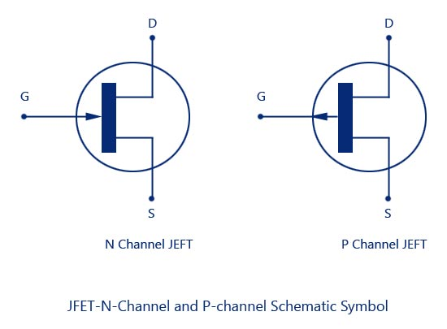
Standard Notations in FET
Source – The terminal through which the majority carriers enter the channel, is called the source terminal S and the conventional current entering the channel at S is designated as I_{g}.
Drain – The terminal, through which the majority carriers leave the channel, is called the drain terminal D and the conventional current leaving the channel at D is designated as I_{D}.
The drain-to-source voltage is called V_{DS}, and is positive if D is more positive than source S
Gate – There are two internally connected heavily doped impurity regions formed by alloying, by diffusion, or by any other method available to create two P-N junctions. These impurity regions are called the gate G. A voltage V_{GS} is applied between the gate and source in the direction to reverse-bias the P-N junction. Conventional current entering the channel at G is designated as I_{G}.
Channel – The region between the source and drain, sandwiched between the two gates is called the channel and the majority carriers move from source to drain through this channel.

Slide 7
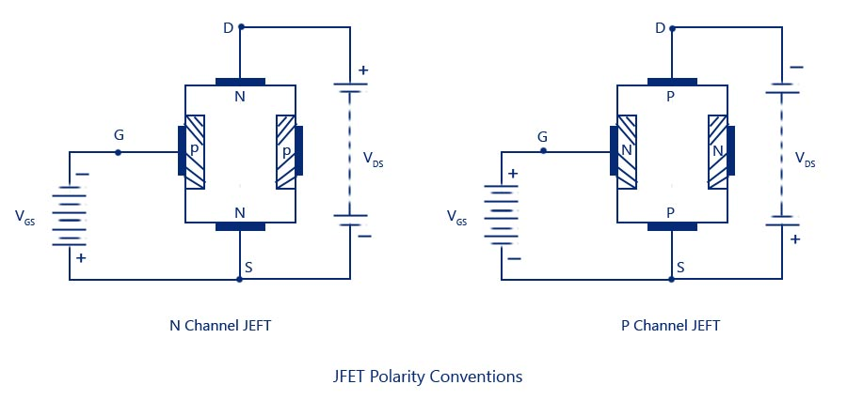
Schematic Symbols of JFET
The schematic symbols for N-type and P-type JFETs are shown in the figure below. The vertical line in the symbol may be thought as channel and source S and drain D connected to the line.
Note that the direction of the arrow at the gate indicates the direction in which the gate current flows when the gate junction is forward biased. Thus for the N-channel JFET, the arrow at the gate junction points into the device and in P-channel JFET, it is away from the device.

Slide 8
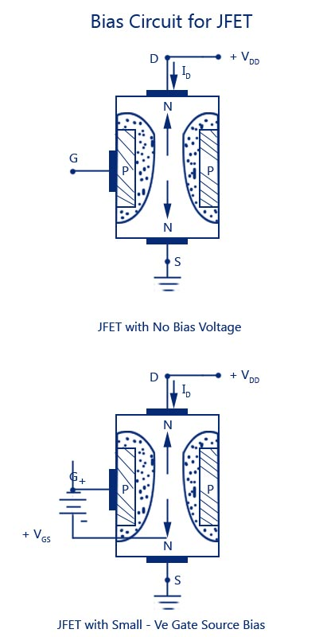
Polarity Conventions-JFET
The polarities for N-channel and P-channel JFET’s are shown in figures.
In both of the cases the voltage between the gate and source is such that the gate is reverse biased.
This is the normal method of connection of JFET’s.
The drain and source terminals are interchangeable, that is either end can be used as a source and the other end as a drain.
The source terminal is always connected to that end of the drain voltage supply which provides the necessary charge carriers, that is, in an N-channel JFET source terminal, S is connected to the negative end of the drain voltage supply for obtaining.

Slide 9
Operation of JFET
Let us consider an N-channel JFET for discussing its operation.
When neither any bias is applied to the gate (i.e. when V_{GS} = 0) nor any voltage to the drain w.r.t. source (i.e. when V_{DS} = 0), the depletion regions around the P-N junctions , are of equal thickness and symmetrical.
When positive voltage is applied to the drain terminal D w.r.t. source terminal S without connecting gate terminal G to supply, as illustrated in fig. 9.4, the electrons (which are the majority carriers) flow from terminal S to terminal D whereas conventional drain current I_{D} flows through the channel from D to S.
Due to flow of this current, there is uniform voltage drop across the channel resistance as we move from terminal D to terminal S.
This voltage drop reverse biases the diode. The gate is more “negative” with respect to those points in the channel which are nearer to D than to S.
Hence, depletion layers penetrate more deeply into the channel at points lying closer to D than to S.
Thus wedge-shaped depletion regions are formed, as shown in figure. when Vd_{s} is applied.
The size of the depletion layer formed determines–the width of the channel and hence the magnitude of current I_{D} flowing through the channel.

Slide 10
Operation of JFET
To see how the width of the channel varies with the variation in gate voltage, let us assume that the gate is negative biased with respect to the source while the drain is applied with positive bias with respect to the source. This is shown in the figure above.
The P-N junctions are then reverse biased and depletion regions are formed. P regions are heavily doped compared to the N-channel, so the depletion regions penetrate deeply into the channel.
Since a depletion region is a regions depleted of the charge carriers, it behaves as an insulator. The result is that the channel is narrowed, the resistance is increased and drain current I_{D} is reduced. If the negative voltage at the gate is again increased, depletion layers meet at the center and the drain current s cut-off completely.
If the negative bias to the gate is reduced, the width of the depletion layers gets reduced causing decrease in resistance and , therefore, increase in drain current I_{D}.(The gate-source voltage V_{GS} at which drain current I_{D} is cut-off completely (pinched off) is called the pinch-off voltage V_{p}.
It is also to be noted that the amount of reverse bias is not the same throughout the length of the P-N junction.
When the drain current flows through the channel, there is a voltage drop along its length.
The result is that the reverse bias at the drain end is more than that at the source end making the width of depletion layer more at the drain.
To see how the width of the channel varies with the variation in gate, go through the figure above.

Slide 11
Characteristics of JFET's
Output or drain characteristic
1. Drain Characteristic With Shorted-Gate
2. Drain Characteristics With External Bias
Transfer characteristic.

Slide 12
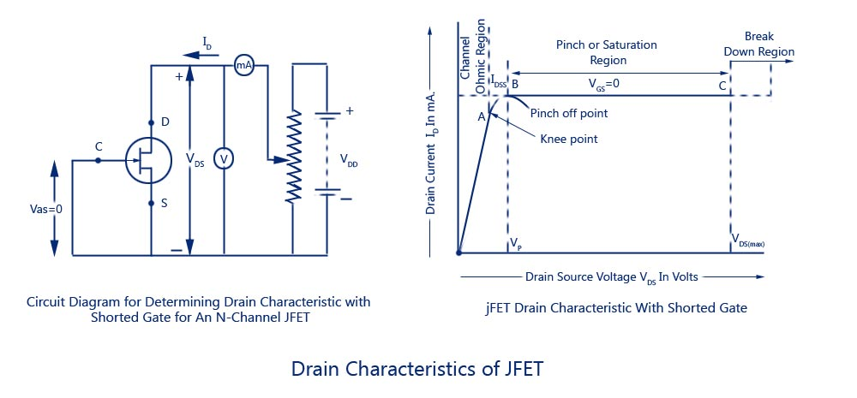
Output or Drain Characteristic.
Drain Characteristic With Shorted-Gate

Slide 13
Drain Characteristic With Shorted-Gate
The circuit diagram for determining the drain characteristic with shorted-gate for an N-channel JFET is given in figure. and the drain characteristic with shorted-gate is shown in another figure.
Initially when drain-source voltage V_{ns} is zero, there is no attracting potential at the drain, so no current flows inspite of the fact that the channel is fully open. This gives drain current Ip = 0.
For small applied voltage V_{na}, the N-type bar acts as a simple semiconductor resistor, and the drain current increases linearly with_the increase in Vds, up to the knee point.
This region, (to the left of the knee point) of the curve is called the channel ohmic region, because in this region the FET behaves like an ordinary resistor.

Slide 14
Drain Characteristic With Shorted-Gate
With the increase in drain current I_{D}, the ohmic voltage drop between the source and channel region reverse-biases the gate junction.
The reverse-biasing of the gate junction is not uniform throughout., The reverse bias is more at the drain end than that at the source end of the channel, so with the increase in Vds, the conducting portion of the channel begins to constrict more at the drain end.
Eventually, a voltage Vds is reached at which the channel is pinched off. The drain current I_{D} no longer increases with the increase in Vds.
It approaches a constant saturation value. The value of voltage V_{DS} at which the channel is pinched off (i.e. all the free charges from the channel get removed), is called the pinch-off voltage V_{p}.
The pinch-off voltage Vp, not too sharply defined on the curve, where the drain current I_{D} begins to level off and attains a constant value. From point A (knee point) to the point B (pinch-off point) the drain current I_{D} increases with the increase In voltage V_{ds} following a reverse square law.
The region of the characteristic in which drain current I_{D} remains fairly constant is called the pinch-off region. It is also sometimes called the saturation region or amplifier region.
In this region the JFET operates as a constant current device since drain current (or output current) remains almost constant. It is the normal operating region of the JFET when used as an amplifier. The drain current in the pinch-off region with V_{GS} = 0 is referred to the drain-source saturation current, Idss).

Slide 15
Drain Characteristic With Shorted-Gate
It is to be noted that in the pinch-off (or saturation) region the channel resistance increases in proportion to increase in V_{DS} and so keeps the drain current almost constant and the reverse bias required by the gate-channel junction is supplied entirely by the voltage drop across the channel resistance due to flow of I_{Dsg} and not by the external bias because V_{GS} = 0
Drain current in the pinch-of region is given by Shockley’s equation
where I_{D} is the drain current at a given gate-source voltage V_{GS}, I_{DSS} is the drain-current with gate shorted to source and V_{GS} (_{0FF}) is the gate-source cut-off voltage.
If the drain-source voltage, Vds is continuously increased, a stage comes when the gate-channel junction breaks down. At this point current increases very rapidly. and the JFET may be destroyed. This happens because the charge carriers making up the saturation current at the gate channel junction accelerate to a high velocity and produce an avalanche effect.

Slide 16
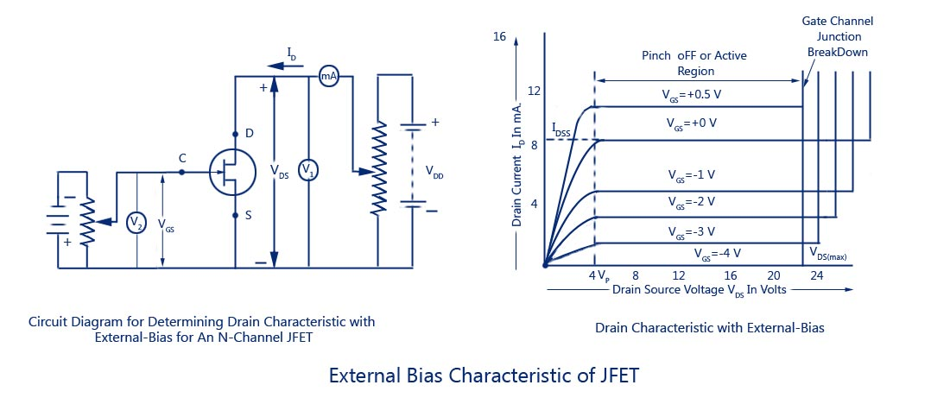
Output or Drain Characteristic.
Drain Characteristics With External Bias

Slide 17
Drain Characteristic With External Bias
The circuit diagram for determining the drain characteristics with different values of external bias is shown in figure. and a family of drain characteristics for different values of gate-source voltage V_{GS} is given in next figure
It is observed that as the negative gate bias voltage is increased
The maximum saturation drain current becomes smaller because the conducting channel now becomes narrower.
Pinch-off voltage is reached at a lower value of drain current I_{D} than when V_{GS} = 0. When an external bias of, say – 1 V is applied between the gate and the source, the gate-channel junctions are reverse-biased even when drain current, I_{D} is zero. Hence the depletion regions are already penetrating the channel to a certain extent when drain-| source voltage, V_{DS} is zero. Due to this reason, a smaller voltage drop along the channel (i.e. smaller than that for V_{GS} = 0) will increase the depletion regions to the point where 1 they pinch-off the current. Consequently, the pinch-off voltage V_{P} is reached at a lower 1 drain current, I_{D} when V_{GS} = 0.
The ohmic region portion decreases.
Value of drain-source voltage V_{DS} for the avalanche breakdown of the gate junction is reduced.

Slide 18
Drain Characteristic With External Bias
Value of drain-source voltage, V_{DS} for breakdown with the increase in negative bias voltage is reduced simply due to the fact that gate-source voltage, VGS keeps adding to the I reverse bias at the junction produced by current flow.
Thus the maximum value of VDS I that can be applied to a FET is the lowest voltage which causes avalanche breakdown.
It is also observed that with VGS = 0, ID saturates at IDSS and the characteristic shows VP = 4 V. When an external bias of – 1 V is applied, the gate-channel junctions still require -4 V to achieve pinch-off. It means that a 3 V drop is now required along the channel instead of the previous 4.0 V.
Obviously, this drop of 3 V can be achieved with a lowervalue of drain current, Similarly when VGS = – 2 V and – 3 V, pinch-off is achieved with 2 V and 1 V respectively, along the channel.
These drops of 2 V and 1 V are, of course, achieved with further reduced values of drain current, ID. It is further observed that when the gate-source bias is numerically equal to pinch-off voltage, VP (-4 V in this case), no channel drop is required and, therefore, drain current, ID is zero.
The gate-source bias voltage required to reduce drain current, ID to zero is designated the gate-source cut-off voltage, VGS /0FF) and, as explained.

Slide 19
Drain Characteristic With External Bias
Hence for working of JFET in the pinch-off or active region it is necessary that the following conditions be fulfilled.
V_{P} < V_{DS} < V_{DS (max)}
V_{GS (OFF)}< V_{GS} < 0
0 < I_{D} < I_{DSS}

Slide 20
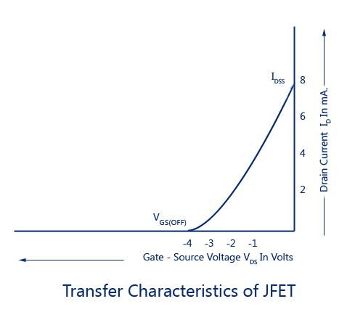
Transfer Characteristic of JFET

Slide 21
Transfer Characteristic of JFET
The transfer characteristic for a JFET can be determined experimentally, keeping drain-source voltage, V_{DS} constant and determining drain current, I_{D} for various values of gate-source voltage, V_{GS}.
The circuit diagram is shown in fig. 9.7 (a).
The curve is plotted between gate-source voltage, V_{GS} and drain current, I_{D}, as illustrated in fig. 9.8. It is similar to the transconductance characteristic of a vacuum tube or a transistor. It is observed that
(i) Drain current decreases with the increase in negative gate-source bias
(ii) Drain current, I_{D} = I_{DSS} when V_{GS} = 0
(iii) Drain current, I_{D} = 0 when V_{GS} = V_{D} The transfer characteristic follows equation (9.1)
The transfer characteristic can also be derived from the drain characteristic by noting values of drain current, I_{D}corresponding to various values of gate-source voltage, V_{GS} for a constant drain-source voltage and plotting them.
It may be noted that a P-channel JFET operates in the same way and have the similar characteristics as an N-channel JFET except that channel carriers are holes instead of electrons and the polarities of V_{GS} and V_{DS} are reversed.

Slide 22
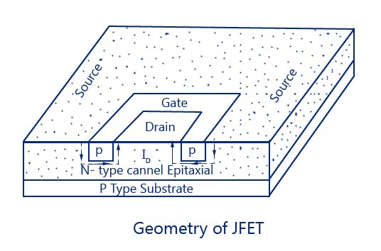
Geometry of JFET

Slide 23
BJT VS FET
BJT | FET
High voltage gain | Low voltage gain
Low current gain | High current gain
Low input impedance | Very high input impedance
Low output impedance | High output impedance
Medium Noise Generation | Low Noise generation
Medium switching time | Fast switching time
Robust | Easily damaged
Requires zero input to turn it "OFF" | Some need an input to turn it "OFF"
It is a Current controlled device. | It is a Voltage controlled device.
Cheap | More expensive than BJT.
Easy to bias | Difficult to bias

